Slide 1
Project Design

Slide 2
Systems Architecture
System is made up of a user interface, server, and database.
Server element is provided by firebase.
User interface is developed by our team.
Vue.js to build the UI

Slide 3
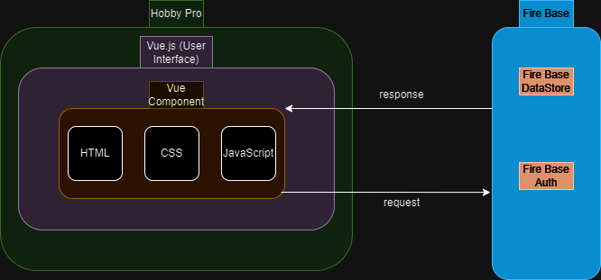
Block Diagram

Slide 4
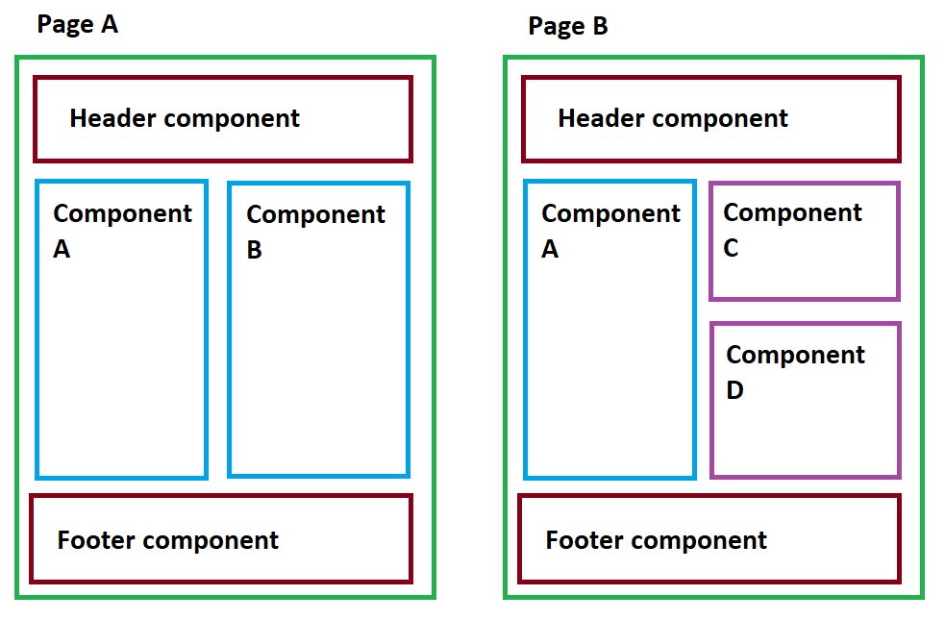
Vue Components

Slide 5
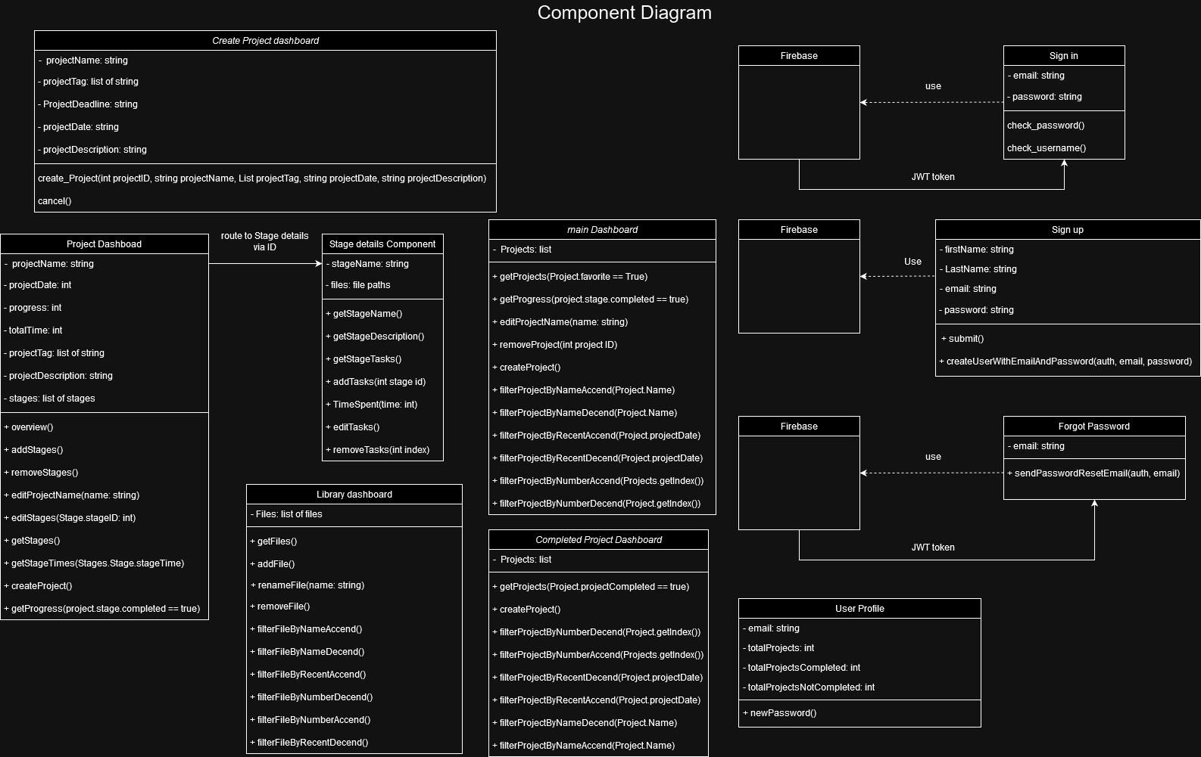
Component Diagram
Most of the components are based on a page-by-page layout.
The main dashboard, library and completed projects page all use the filter methods due to these pages using a list of projects.
The project dashboard can be redirected to multiple stage pages since there are multiple stages per project page. (this works by redirects by ID's)

Slide 6
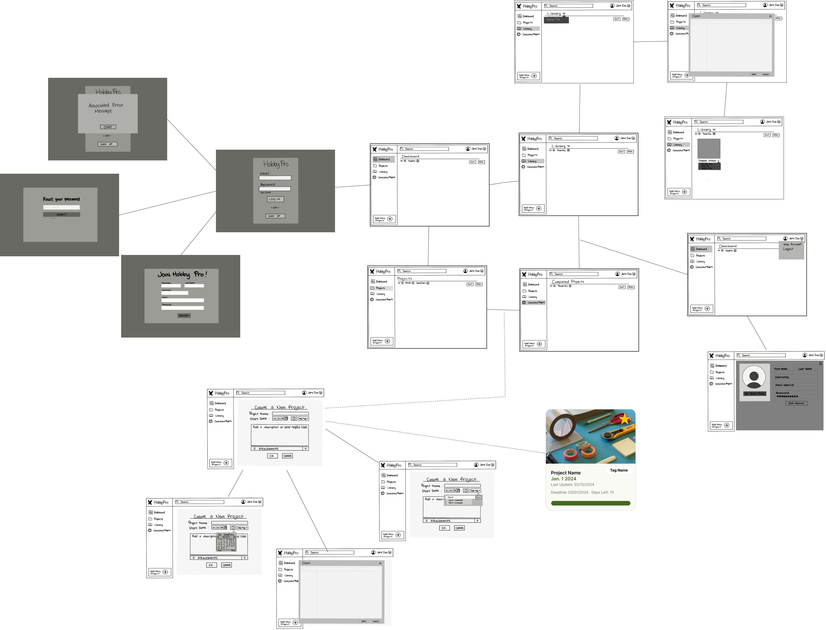
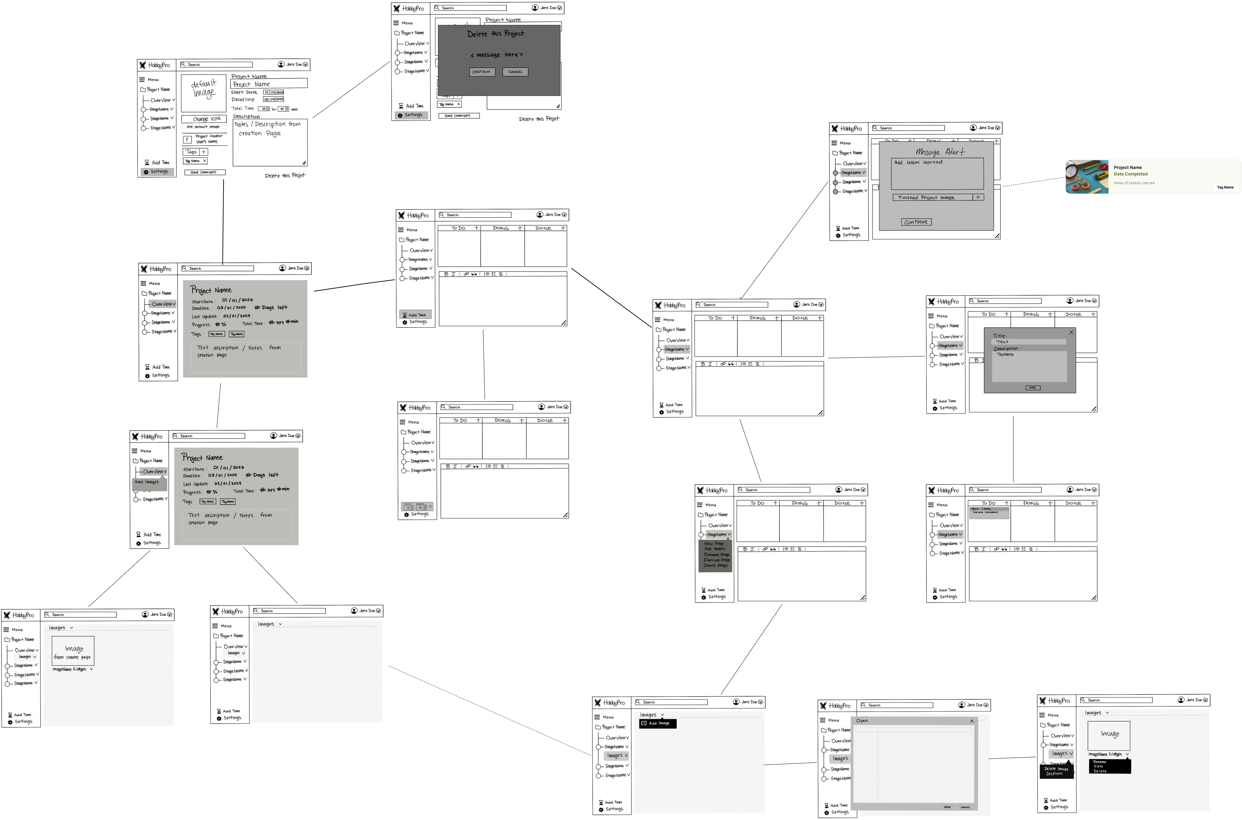
User Interface Storyboard

Slide 7
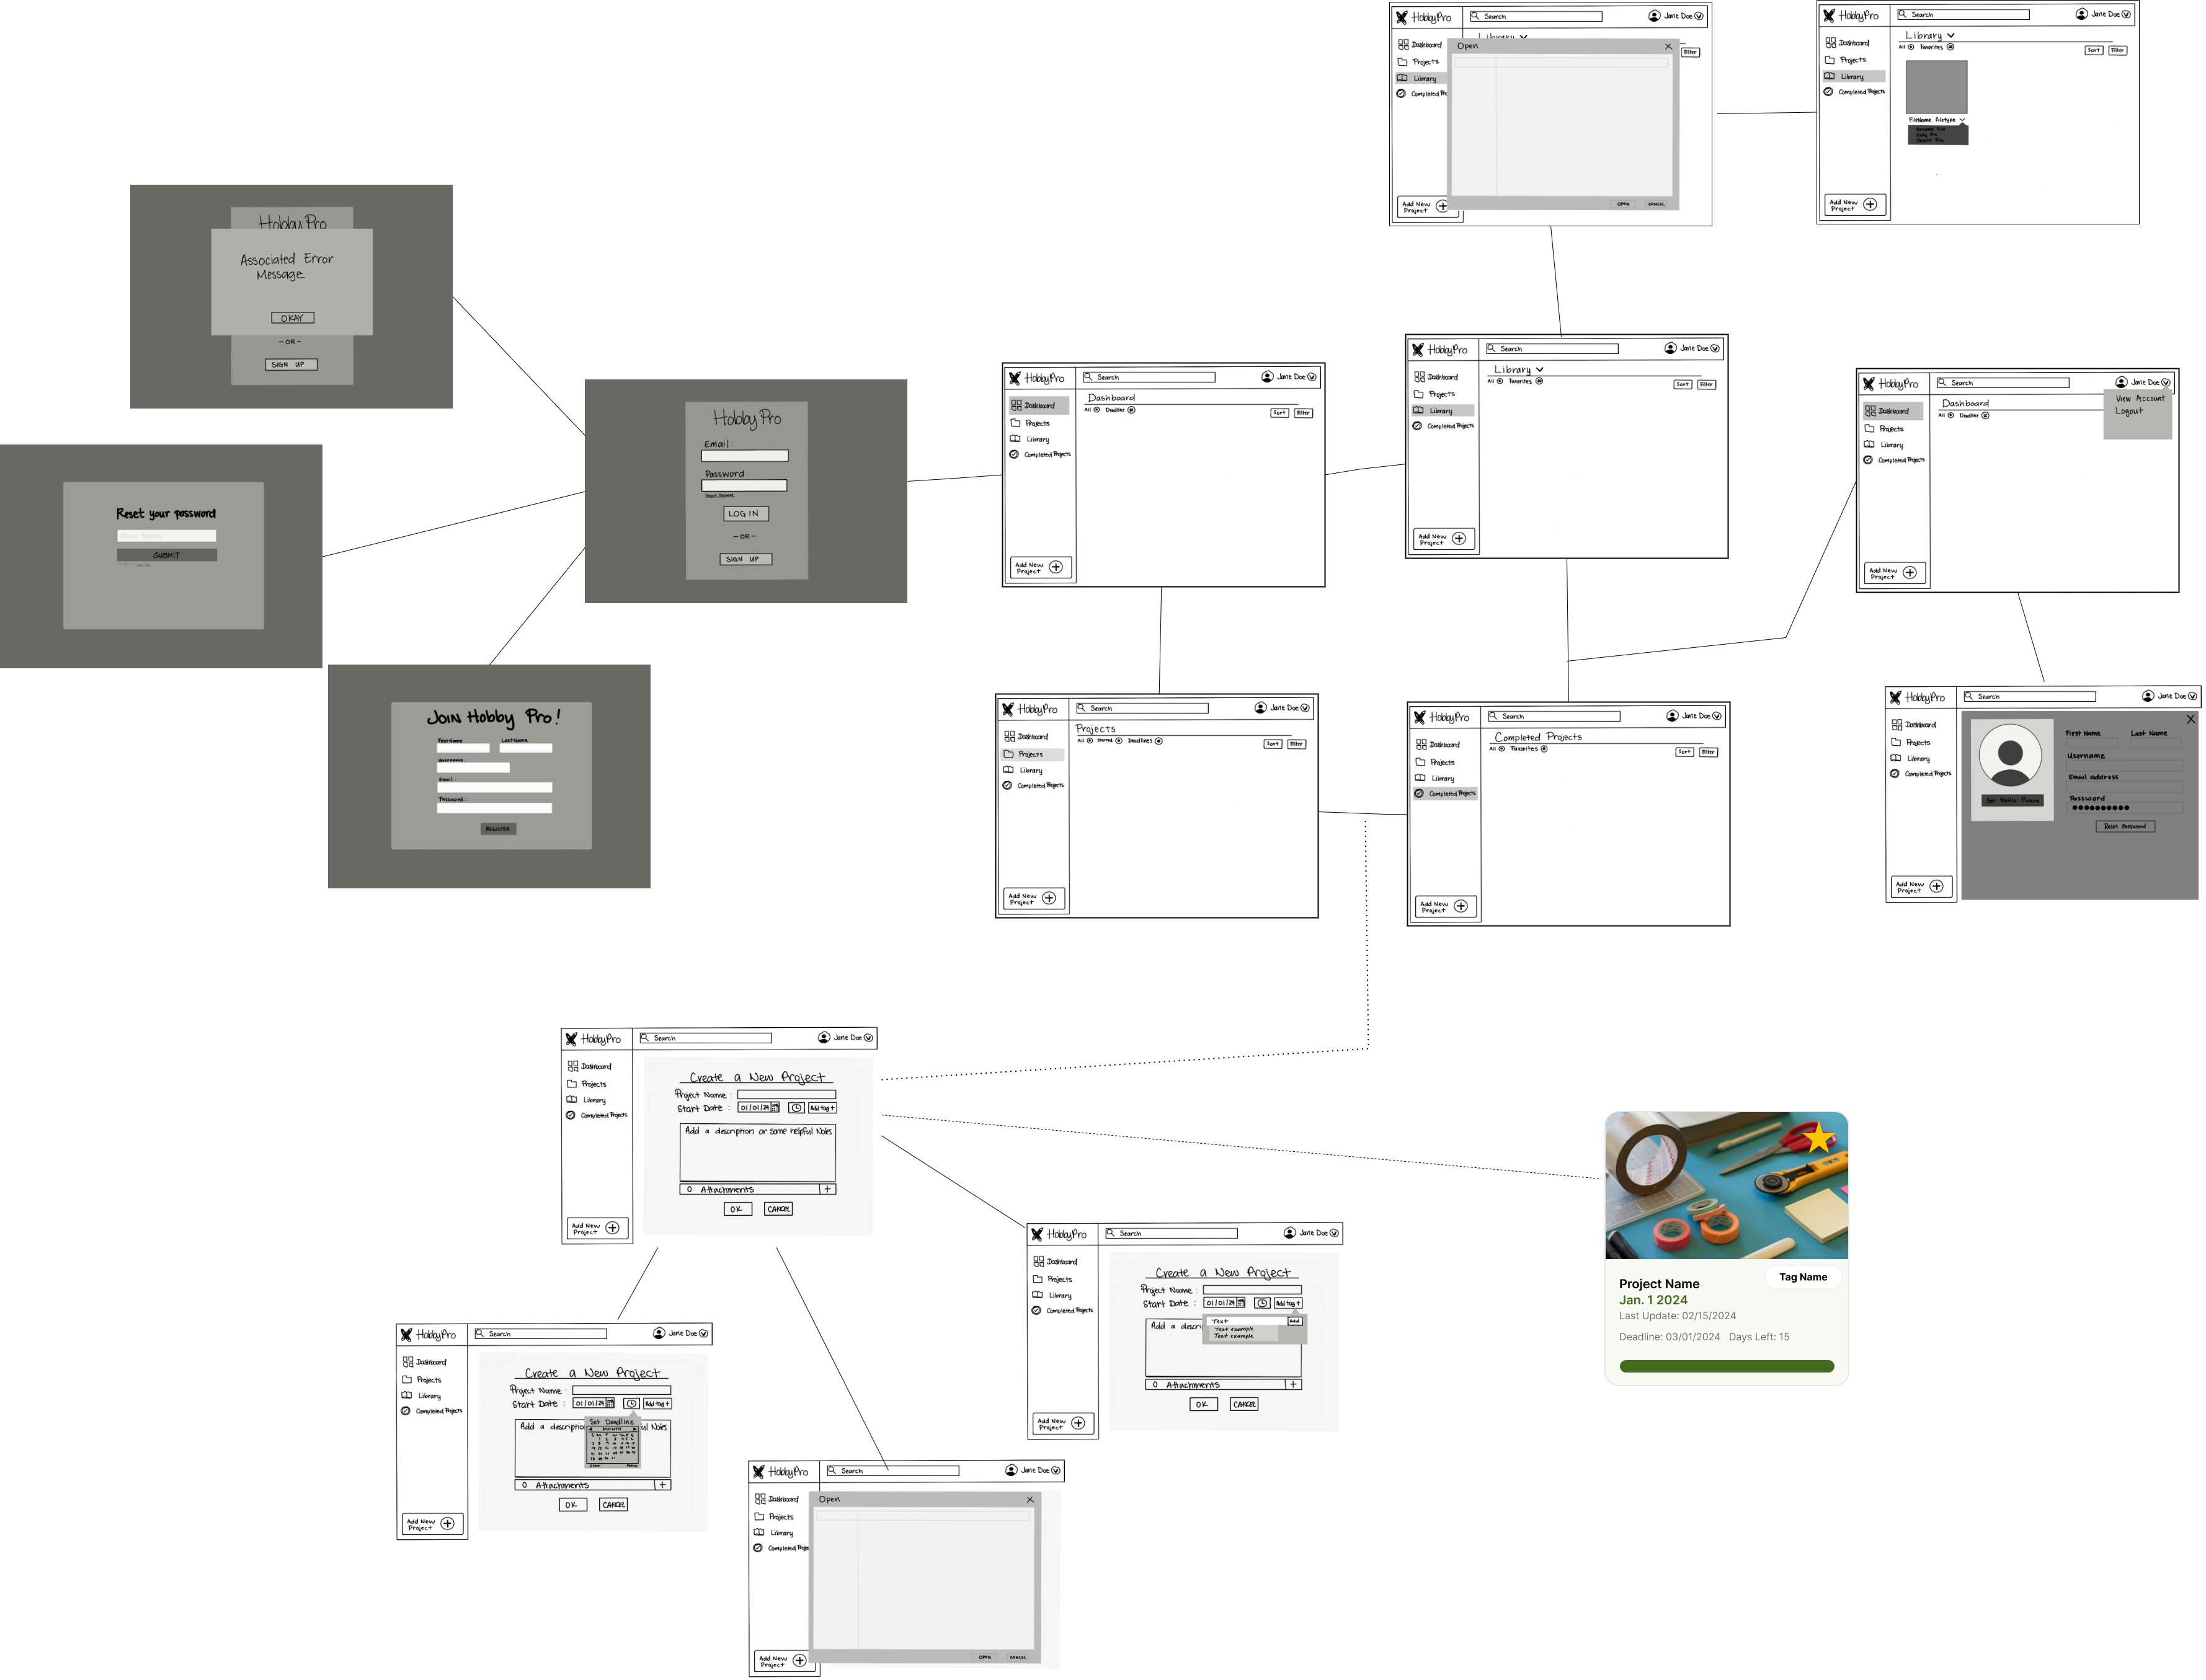
Login Page

Slide 8
Main Pages of Hobby Pro

Slide 9
Library Page

Slide 10
User Profile

Slide 11
Create a New Project

Slide 13
Overview Page

Slide 14
Settings

Slide 15
Adding Time

Slide 16
Stage Functions

Slide 17
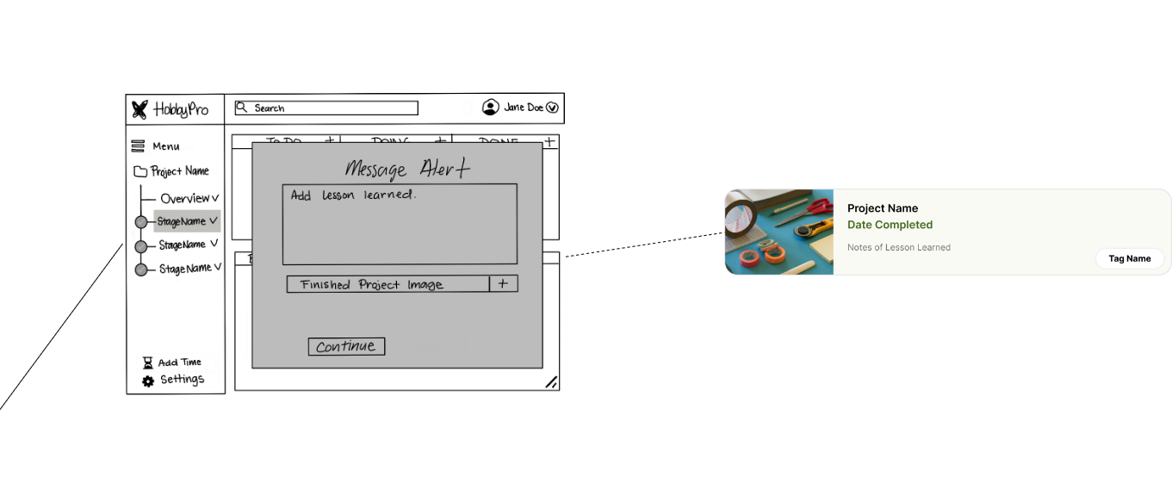
Complete a Project

Slide 18
Message Documentation
Create_Project(String projectName, List ProjectTag, string, ProjectDate, string projectDescription)
setDoc(Project(db, projects, stages){
name = projectName;
tags = ProjectTags;
date = ProjectDate;
description = projectDescription
}
AddStages();
SetDoc(db, Stages){
Completed: false
Time: null
Task: new Taks[]
}
RemoveStages(string: stageId);
DeleteDoc(db, stageID);
EditProjectName(string name)
SetDoc(project(db, "name"){
Name = name;
}

Slide 19
Message Documentation
GetStages(varchar projectId);
{
Completed: Boolean
Time: time
Taks: Task[]
}
GetStageTimes(Stage.Stage.stageTime)
{//from stages
Time: time
}
CreateProject()
{ projectid }
STAGE DETAIL AND COMPONENT
GetstageName(string stageid)
{//Stages
Name: stagename
}
GetStageTasks()
{
Task: tasks
}

Slide 20
Message Documentation
TimeSpent(time time)
{
Time: time
}
RemoveTask(varchar index)
DeleteDoc(db, Task){
Task = index;
}
LIBRARY
GetFiles()
{
List of filepaths to Fire Storage
}
RenameFile(string name)
SetDoc(Storage)
Removefile(string fileName)
DeleteObject(fileName)

Slide 21
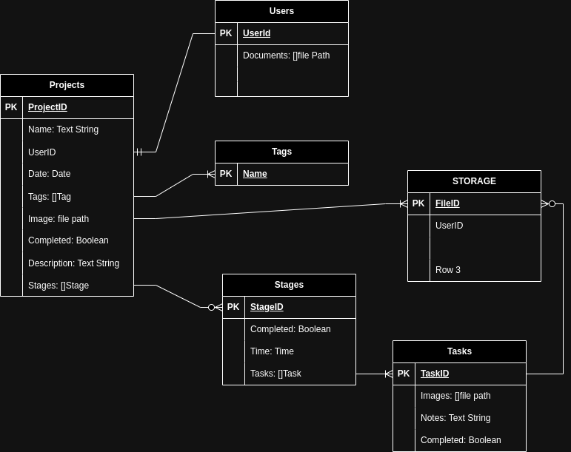
Storage Documentation

